Slide 1
Data Science POC Use Case
Team Name: Prayogshaala
Team : Lakshya Sivaramakrishnan

Slide 2
Data Science POC Use Case
One of Unilever’s brands is going through some major changes in Business Execution plans and will like to know:
What are the major drivers for sales(EQ)?
Knowing the drivers, how can they predict future sales for the next 6 periods?
Tech Used
Python - Pandas, Numpy, Scikit-learn, Matplotlib and Seaborn
Google Cloud Platform to run the models - Compute and Storage

Slide 3
Demo Link
https://github.com/lakshya90/Mishmash-Online-Hackathon
The link contains train and test files, an ipython notebook, test output and a ppt to my findings.

Slide 4
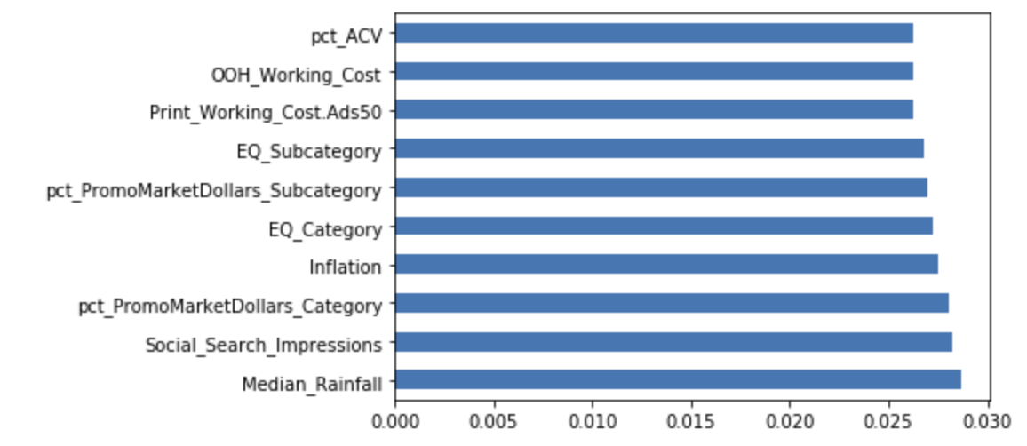
Sales Drivers
The top five drivers for determining sales are:
Median_Rainfall
Social_Search_Impressions
pct_PromoMarketDollars_Category
Inflation
EQ_Category
Methods used to arrive to these features:
Feature Importance of a model [model.feature_importances_]
Seaborn’s(python library) Correlation matrix with heatmap

Slide 5
Models Used
The top five models used for determining sales are:
RandomForestRegressor
GradientBoostingRegressor
LinearRegression
Support Vector Regressor
MLPRegressor
RandomForestRegressor was the best performing and hence we applied it on the test data.
out.csv is the final output file.

